Slide 1
Hotel Bookings & Cancellations
Findings and Recommendations
IST.687.M007.FALL21 | Team 7
Ameya | Christopher | Himamshu | Sazal

Slide 2
Determinants of Cancellations
Guest Preferences
Marketing & Sales
Demographic
Historic
Lead Time
Market Segment
Children
Previous Cancellations
Weekend Stays
Customer Type
Adults
Previous Bookings not cancelled
Weekday Stays
Deposit Type
Babies
Repeat Guest
Meal
Car parking spaces
Special requests
Booking changes
Assigned Room Type
Geographic
Reserved Room Type
Country

Slide 3
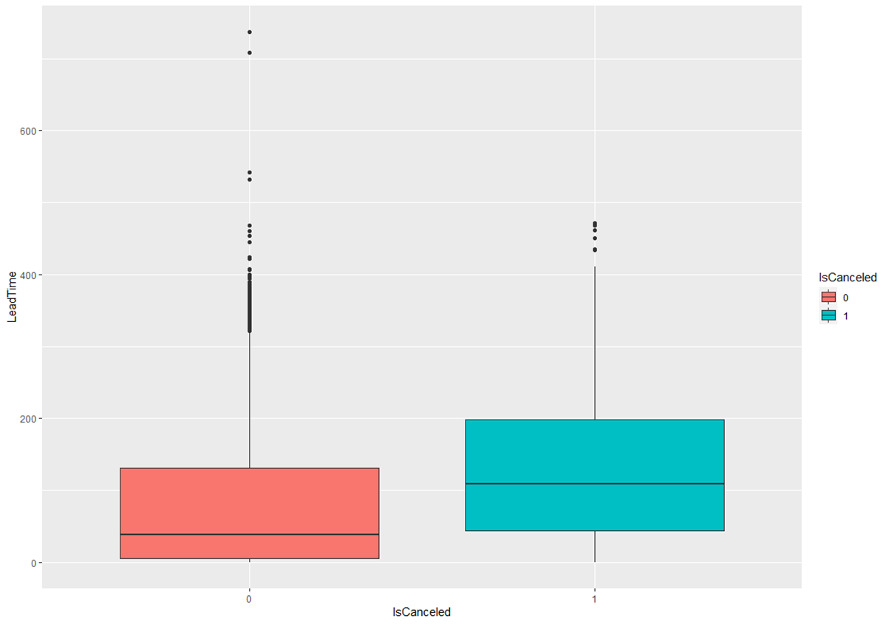
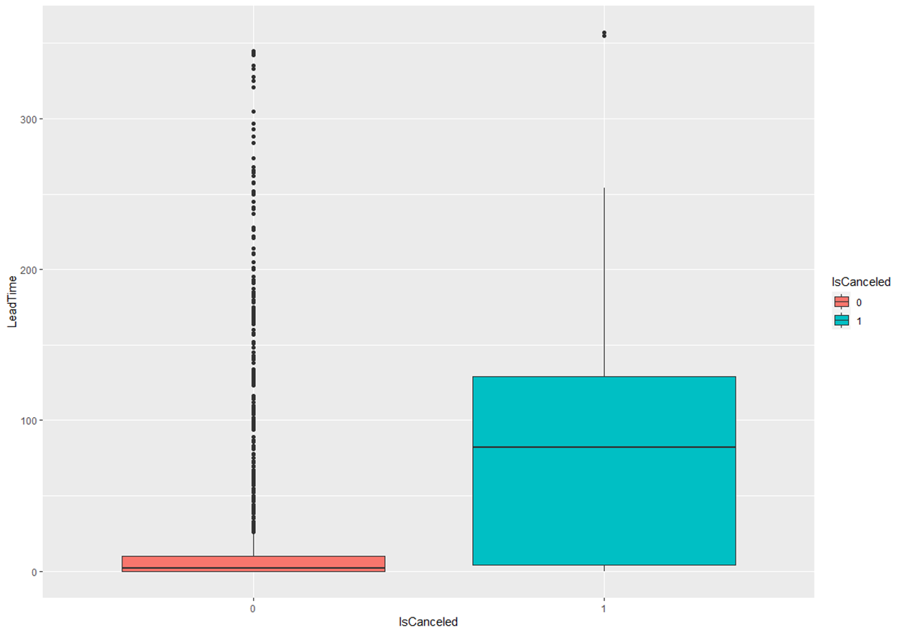
Cancellations likely to increase with longer lead times
First-time guests
Repeat guests
 | Non-Cancelled Bookings | Cancelled Bookings
Mean | 78.84 | 128.68
Median | 38 | 109
Mode | 0 (3079) | 0 (157)
 | Non-Cancelled Bookings | Cancelled Bookings
Mean | 21.02 | 83.77
Median | 2 | 82
Mode | 0 (593) | 82 (29)
50% of non-cancelled bookings have a median lead time of 5 weeks or less.
50% of non-cancelled bookings for repeat guests have a median lead time of 2 days.
Takeaway: Over any period of time, if you have too many bookings with long lead times, consider overbooking.

Slide 4
Repeat guests are less likely to cancel
First-time guests
Repeat guests
Cancelled? | Frequency | Percent
No | 27,271 | 71.2%
Yes | 11,011 | 28.8%
Cancelled? | Frequency | Percent
No | 1,667 | 93.8%
Yes | 111 | 6.2%
Takeaway: If you have a very high proportion of first-time guests booking, consider overbooking, or consider prioritizing repeat guests for the remaining bookings.

Slide 5
Non-refundable deposit does not deter cancellations
Non-cancelled Bookings
Cancelled Bookings
Deposit Type | Frequency | Percent
No Deposit | 28,749 | 99.35%
Non Refund | 69 | 0.24%
Refundable | 120 | 0.41%
Deposit Type | Frequency | Percent
No Deposit | 9,450 | 84.97%
Non Refund | 1650 | 14.84%
Refundable | 22 | 0.20%
Takeaway: Review your deposit policy. Consider raising the amount of non-refund deposits.

Slide 6
Booking changes deter cancellations
Overall bookings
Booking changes
Booking Changes​ | Frequency​ | Percent​
0​ | 32,252​ | 80.5%​
1​ | 5469​ | 13.7%​
2​ | 1561​ | 3.9%​
Deposit Type​ | Frequency​ | Percent​
Non-Cancelled Booking Changes​ | 6654​ | 23%​
Cancelled Booking Changes​ | 1154​ | 10.4%​
​ | ​ | ​
Takeaway: If a booking is highly customized, it has lower chances of getting cancelled in the future

Slide 7
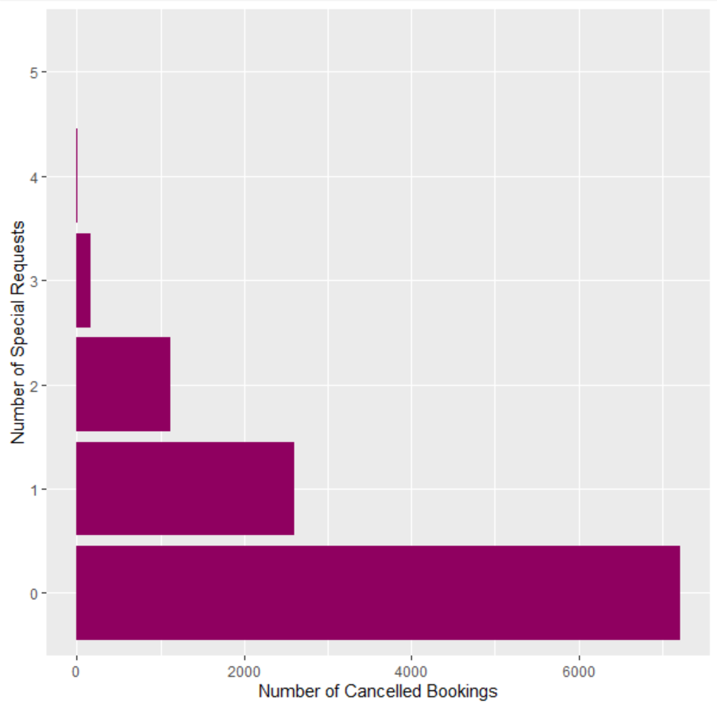
Special requests correspond to decrease in booking cancellations
This can be seen as an increased commitment to a room reservation from the guest’s side, and hence translates to lesser probability of cancellation
1
166
1,127
2,597
Takeaway: If a booking is highly customized, it has lower chances of getting cancelled in the future
7,216

Slide 8
All cancelled bookings have exactly zero requests for car parking space
All bookings
Non-cancelled bookings
Parking Spaces​ | Frequency​ | Percent​
0​ | 34570 | 86.3%​
1​ | 5462​ | 13.6%​
Parking Spaces​ | Frequency​ | Percent​
0​ | 23448​ | 81.0%​
1​ | 5462​ | 18.9%​
Takeaway: If a booking is requested with at least one parking space, it has marginal chances of getting cancelled in the future

Slide 9
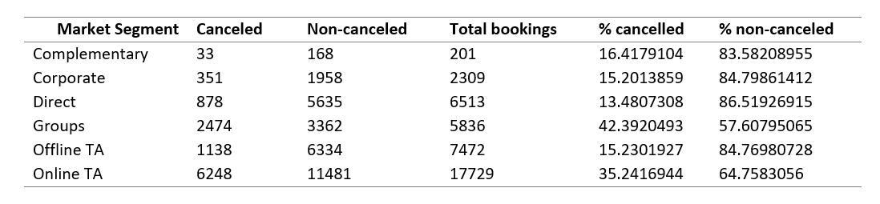
Cancellations for Groups and Online Travel Agents are higher
‘Groups’ have a 42% cancellation rate.
Online TA’ has 35% cancellation rate.
Each of the remaining four segments have an average of 15% cancellation rates only.
Takeaway: If a booking is requested for groups or via an online travel agent, the chances of cancellation are high.

Slide 10
Recommendations
Revise your deposit policy
Promote customization
Prioritize affiliation with Tour Operators

